Slide 1
AVIATION PERFORMANCE METRICS:
Kaushal Patel
Tathagata Dutta
Qilun Lyu
(under the supervision of DR. James Abello, Fangda Han and Nishant Kumar)

Slide 2
End Users
Passengers/Consumers
Airport authorities
Airline Companies

Slide 3
Data Description
Source: Our data has been downloaded from Bureau of Transportation Statistics and the data is at rest.
Coverage:
All 50 US States, e.g. NJ
Including Puerto Rico & U.S. Virgin Islands & U.S. Pacific Trust Territories and Possessions
Excluding Washington D.C.
Timespan: The data is time variant as it ranges from January 2015 to December 2019.
Size:
Raw data: 13-14GB which is in csv format.
>31million records
Storage:
The source data is imported into MySQL for storage in Secondary Memory.

Slide 4
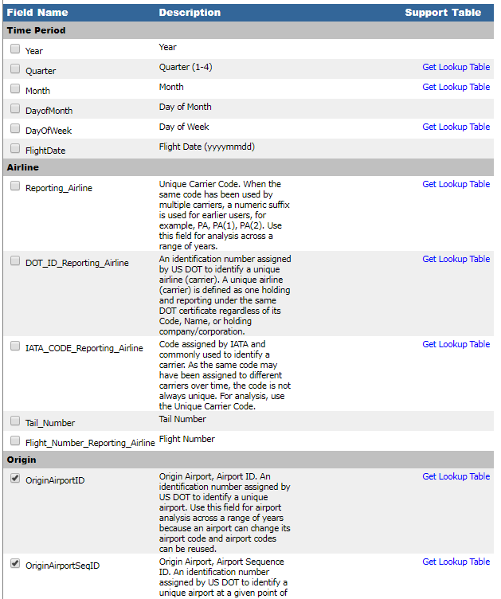
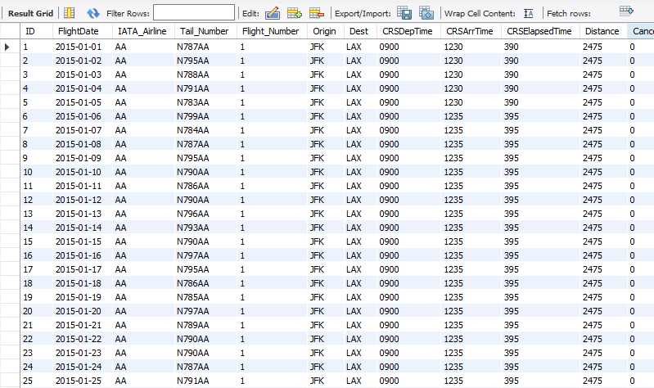
Data Dictionary & Data Snippet

Slide 5
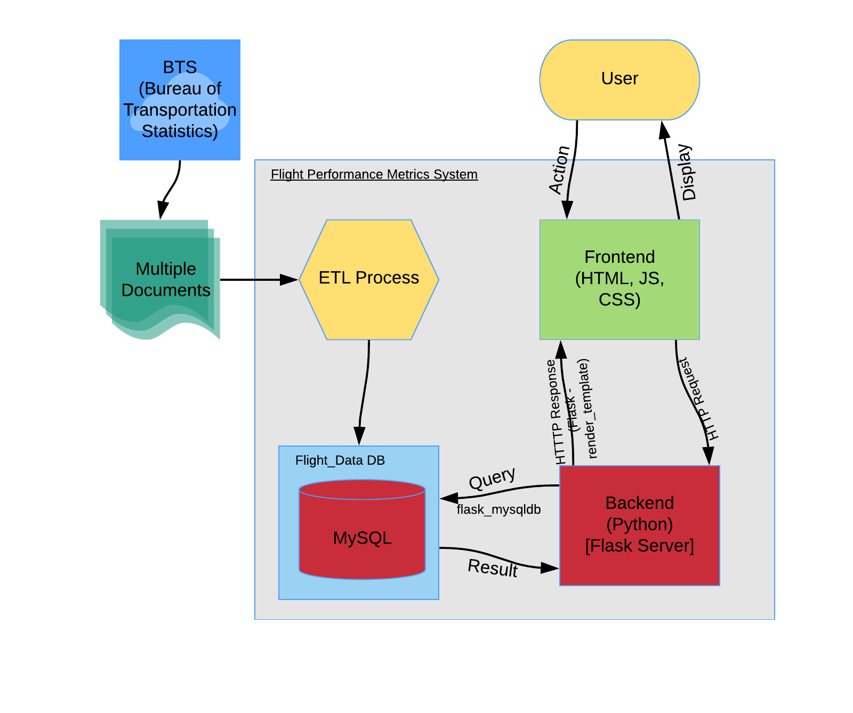
System Flow Diagram

Slide 6
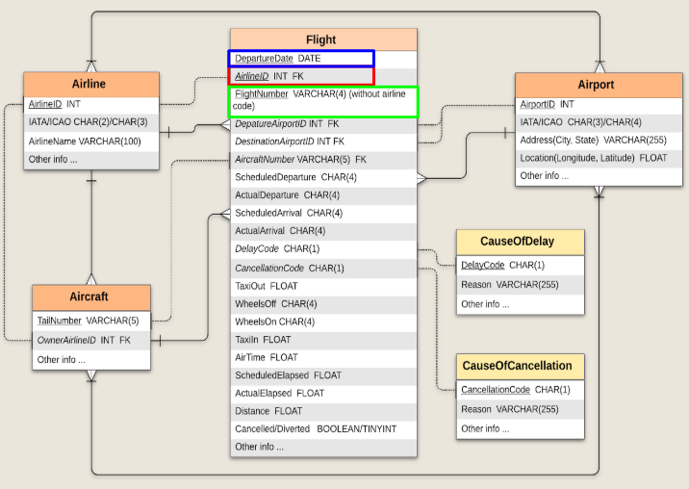
ER Diagram

Slide 7
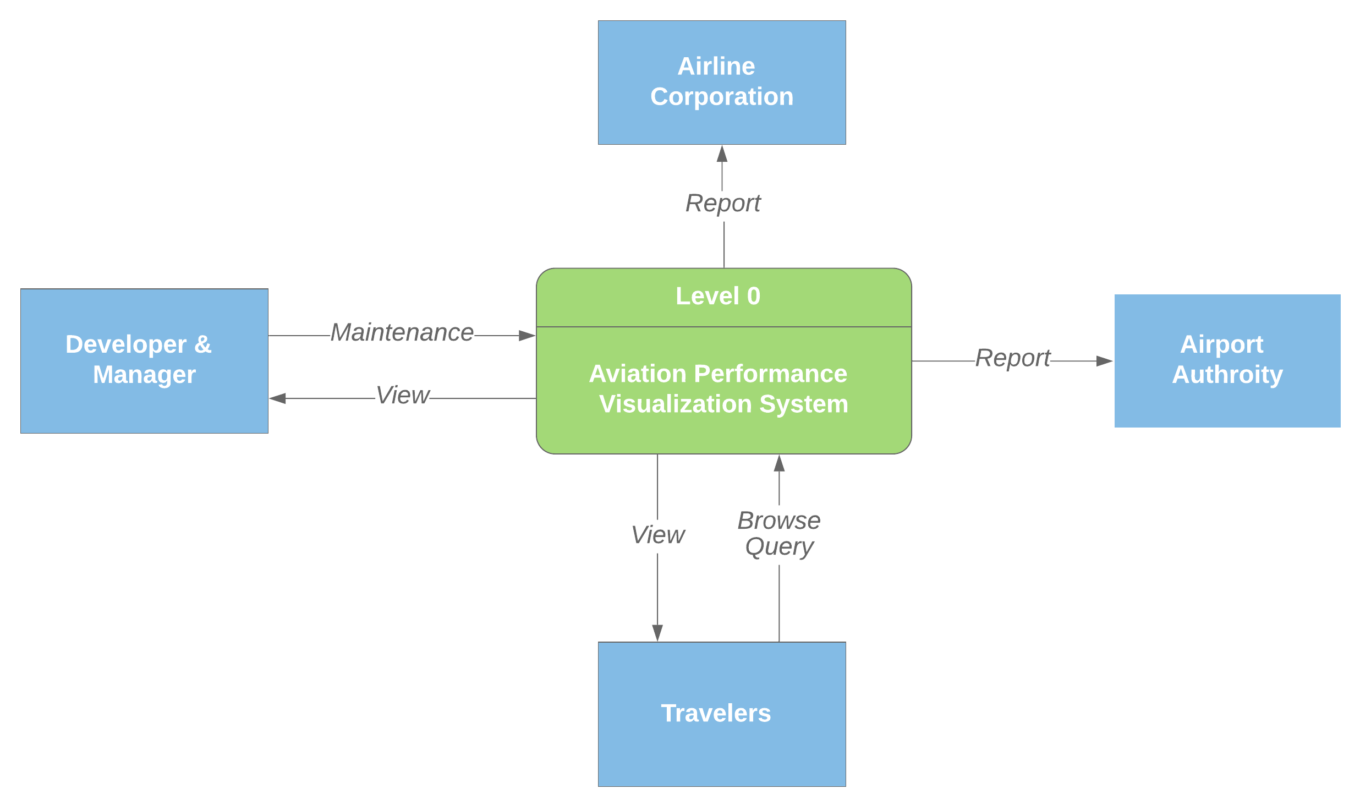
Context Diagram

Slide 8
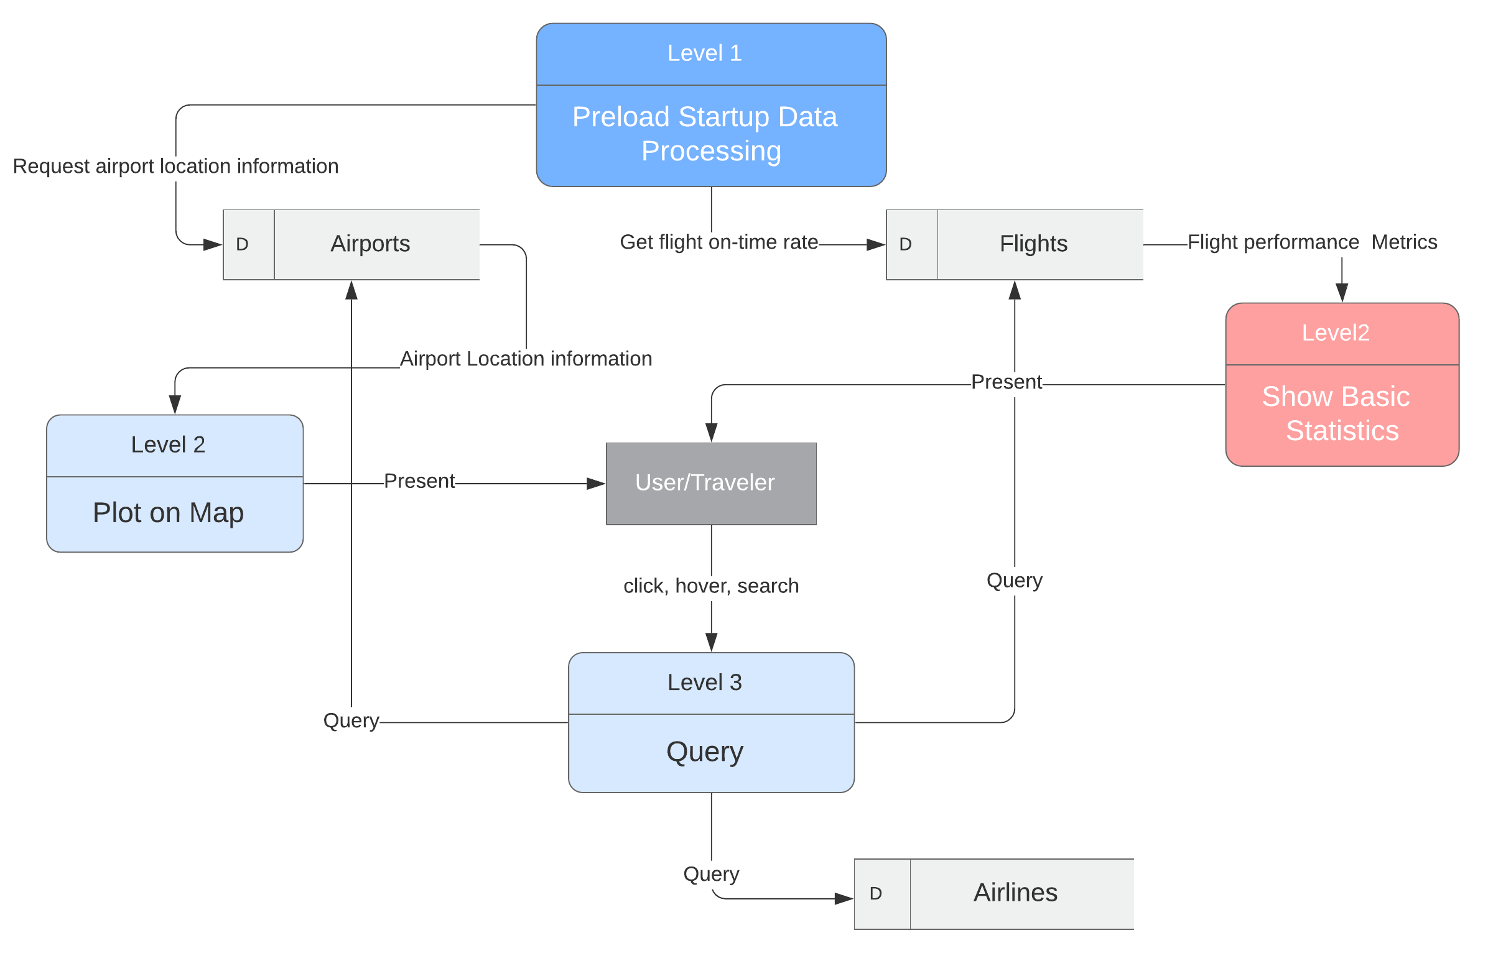
Dataflow Diagram

Slide 9
DEMO

Slide 10
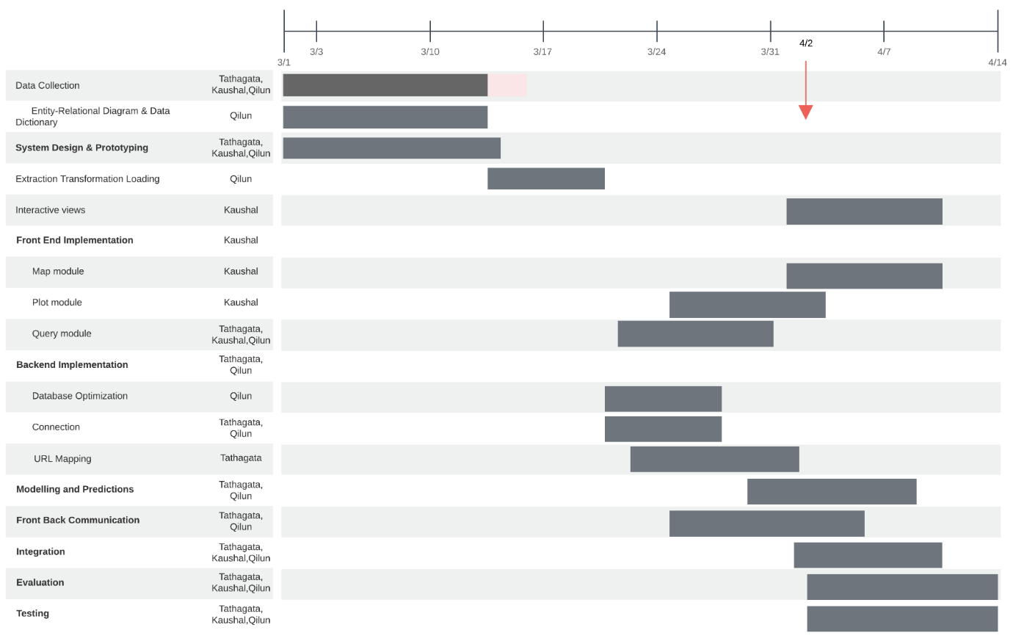
Timeline (Gantt Chart)

Slide 11
Future Work
Improvement of query performance
Implementation of Predictive Model
Addition of more views
Beautification of UI
Testing and Documentation

